Slide 1


Critical Rendering Path
Velocidade também é uma funcionalidade
João Lucas P Santana
jlucasps@gmail.com
Notes:
google dev http://goo.gl/Qcwp06

Slide 2
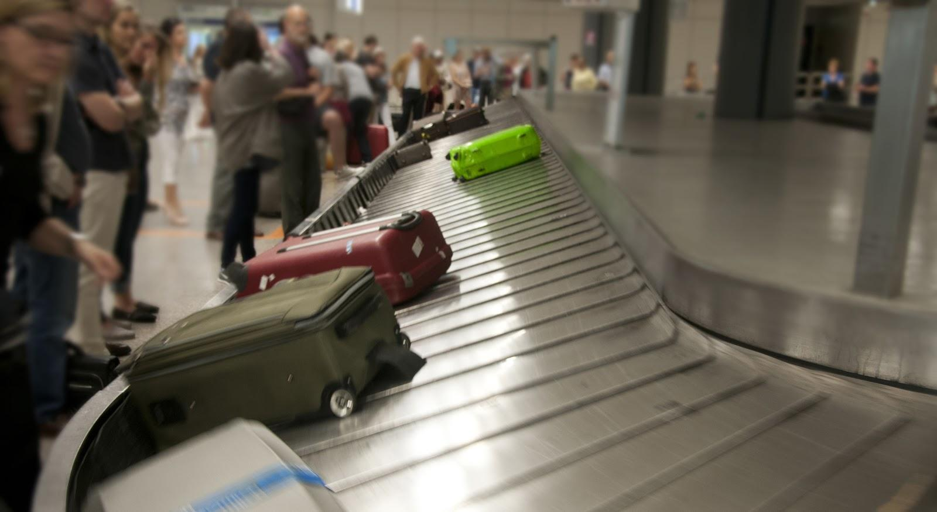
Perception of speed
http://goo.gl/JPG1WP, http://goo.gl/WYF7j

Slide 3
Critical Rendering Path
HTML
DOM
Network
JavaScript
Render Tree
Layout
Paint
CSS
CSSOM

Slide 4
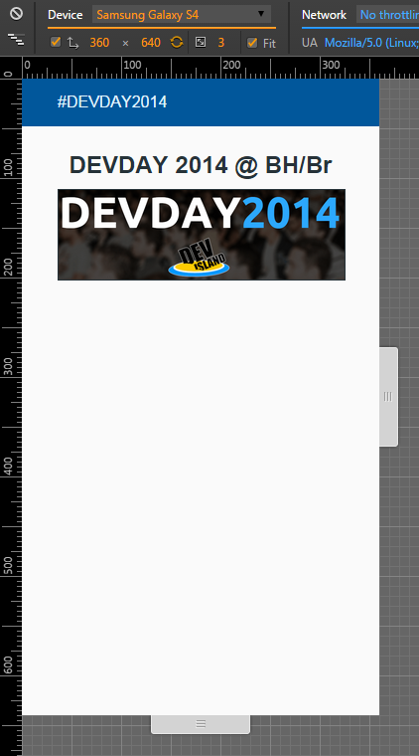
Constructing the DOM
vagrant@precise32:~$ curl 10.0.2.2:3000
<html>
<head>
<title>DEVDAY 2014</title>
<meta name="viewport" content="width=device-width">
<link rel="stylesheet" type="text/css" href="assets/style.css">
</head>
<body>
<header>
<a href="http://devday.devisland.com" target="_blank">#DEVDAY2014</a>
</header>
<section>
<h2>DEVDAY 2014 @ BH/Br</h2>
<img src="assets/devday2013.png">
<h3>Critical Rendering Path</h3>
</section>
</body>
</html>
vagrant@precise32:~$
Notes:
Critical Rendering Path: sequence of steps that the browser goes through to convert HTML/CSS/JS into pixels on the screen

Slide 5
Characters
Tokens
Nodes
DOM
<html>
<head>
<title>DEVDAY 2014</title>
<meta name="viewport" content="width=device-width">
<link rel="stylesheet" type="text/css" href="assets/style.css">
</head>
<body>
<header>
<a href="http://devday.devisland.com" target="_blank">#DEVDAY2014</a>
</header>
<section>
<h2>DEVDAY 2014 @ BH/Br</h2>
<img src="assets/devday2013.png">
<h3>Critical Rendering Path</h3>
</section>
</body>
</html>
StartTag: html
StartTag: head
StartTag: title
DEVDAY 2014
EndTag: title
Tag: meta
Tag: link
EndTag: head
StartTag: body
StartTag: header
StartTag: a
#DEVDAY2014
http://goo.gl/6ptLCJ
Notes:
Tokenizer emits tokens for every html tag

Slide 6
Constructing the DOM
3c 68 74 6d 6c 3e 3c 68 65 61 64 3e 3c 74 69 74 6c 65 3e 44 45 56 44 41 59 65 ...
Characters
<html><head><title>DEVDAY 2014</title><meta..><link..></head><body><header><a href="h ...
Tokens
StartTag: html
StartTag: head
StartTag: title
...
EndTag: title
Tag: meta
Tokenizer
Nodes
html
head
title
DEVDAY2014
meta
...
h2
DEVDAY 2014 @ BH/Br
html
DOM
head
body
title
meta
link
header
type="text/css"
a
href="assets/style.css"
DEVDAY 2014
rel="stylesheet"
Tree builder
#DEVDAY2014
Notes:
HTML specs define the rules for browsers parse data into a DOM
DOM created incrementally
DOM captures the content and properties of the html and all the relationships between the nodes

Slide 7
DOM - Document Object Model
parsing incremental
inicia-se ao receber os primeiros bytes
conteúdo, propriedades e relacionamento entre os nodes

Slide 8
Critical Rendering Path
HTML
DOM
Network
JavaScript
Render Tree
Layout
Paint
CSS
CSSOM

Slide 9
Construindo o CSSOM
Characters
20 62 6f 64 79 20 7b 20 20 20 20 20 66 6f 6e 74 2d 66 61 6d 69 6c 79 3a 20 5c 27 ...
body{font-family:Roboto,sans-serif;background-color:#fafafa;color:#263238}article, ...
html
Tokens
body {
font-family: 'Roboto', sans-serif;
background-color: #fafafa;
color: #263238; }
Nodes
body
header {
font-family: 'Roboto', sans-serif;
bg-color: #01579b;
color: #e1f5fe; }
CSSOM
header
section
header a {
color: #e1f5fe;
text-decoration: none; }
a
h2
#DEVDAY2014
DEVDAY 2014 @ BH/Br
http://goo.gl/6ptLCJ
Notes:
CSSOM can not apply the the same incremental processing like DOM

Slide 10
Construindo o CSSOM
<link href="style.css" rel="stylesheet">
<link href="print.css" rel="stylesheet" media="print">
<link href="other.css" rel="stylesheet" media="(min-width: 400px)">
<link href="portrait.css" rel="stylesheet" media="orientation:portrait">
<link href="landscape.css"rel="stylesheet" media="(orientation: landscape)">
@media (min-width: 500px) and (max-width: 600px) {
/* styles here */
}
http://goo.gl/m6QlkF, http://goo.gl/FCAK6A

Slide 11
CSSOM - CSS Object Model
parsing não incremental
render blocking
recalculate styles

Slide 12
Critical Rendering Path
HTML
DOM
Network
JavaScript
Render Tree
Layout
Paint
CSS
CSSOM

Slide 13

section {
display: block;
text-align: center; }
section
CSSOM
DOM
section
h2
img
h3
h2
img
h3
DEVDAY 2014 @ BH/Br
DEVDAY 2014 @ BH/Br
section h2 {
font-weight: bold; }
section h3 {
display: none;}
section img {
width: 100%;
border: 1px #263238 solid; }
section
Render Tree
h2
img
h3
DEVDAY 2014 @ BH/Br
http://goo.gl/ouzsUr

Slide 14
Render Tree
DOM e CSSOM formam Render Tree
Somente nodes visíveis na página

Slide 15
Critical Rendering Path
HTML
DOM
Network
JavaScript
Render Tree
Layout
Paint
CSS
CSSOM

Slide 16
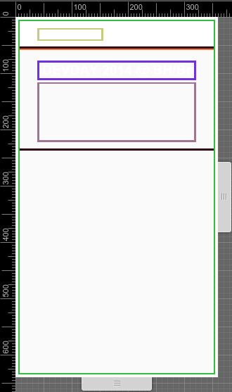
Layout
onde e como os elementos serão posicionados na tela
↑ tamanho ou complexidade do DOM/CSSOM
↑ tempo em Layout
http://goo.gl/0L9usy
Notes:
Layout can be triggered by device orientation change on mobile, a window resize, or any other action that modifies the content of the DOM - e.g. adding or removing content from the DOM tree, toggling CSSOM properties on a node, and so on!

Slide 17
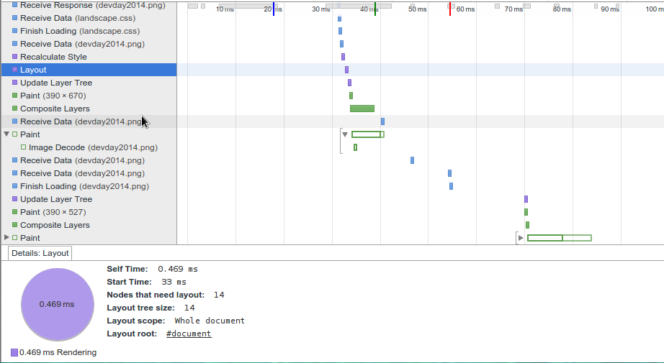
tree size, scope, root

Slide 18
Critical Rendering Path
HTML
DOM
Network
JavaScript
Render Tree
Layout
Paint
CSS
CSSOM

Slide 19
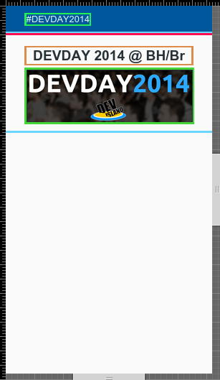
Painting
influências:
tamanho da área
formato (bordas)
sombras
transparências
background-images
Render Tree
Layout
Paint

Slide 20
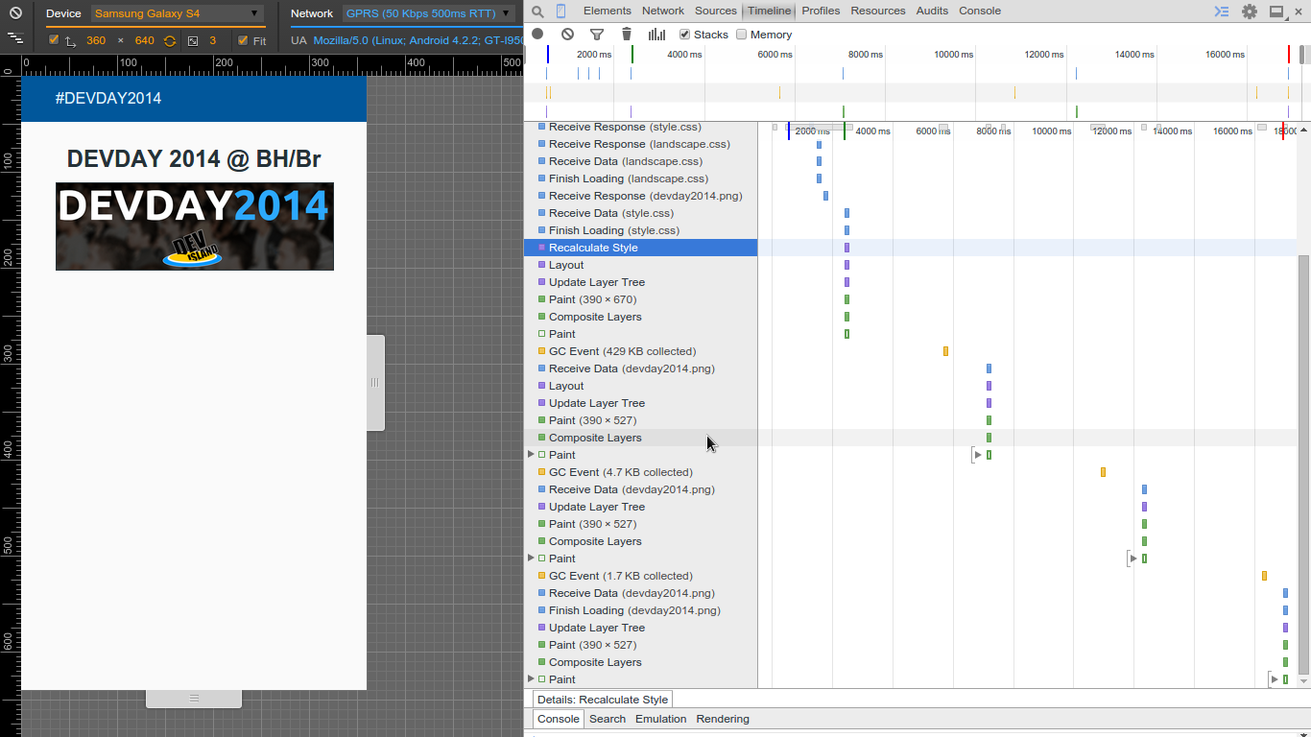
http://goo.gl/xjZAiJ

Slide 21
Critical Rendering Path
HTML
DOM
Network
JavaScript
Render Tree
Layout
Paint
CSS
CSSOM

Slide 22
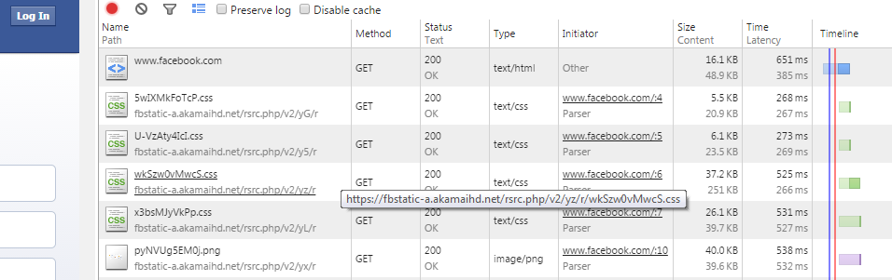
Otimizando o DOM
minify, compress, cache
http://goo.gl/hPLUqB, http://goo.gl/CW7HJC, http://goo.gl/wxIXkU
Notes:
remove comments, tabs, spaces
enable gzip on the server
CDN, fingerprint, client-side cache

Slide 23
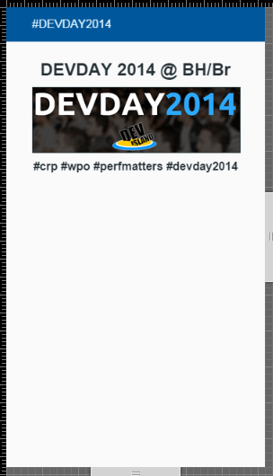
JavaScript
<section>
<h2>DEVDAY 2014 @ BH/Br</h2>
<img src="assets/devday2014.png">
<h3>Critical Rendering Path</h3>
</section>
<script type="text/javascript">
var section = document.getElementsByTagName('section')[0],
span = document.createElement('span');
span.innerText = "#crp #wpo #perfmatters #devday2014";
span.style.fontWeight = "bold";
section.appendChild( span );
</script>

Slide 24
... .. ... ..
<h3>Critical Rendering Path</h3>
</section>
<script type="text/javascript" src="assets/effects.js"></script>
</body>
Build
DOM
parser blocked
Run JS
GET effects.js
response

Slide 25
<head>
<meta name="viewport" content="width=device-width, initial-scale=1">
<link rel="stylesheet" type="text/css" href="assets/style.css">
</head>
<body>
<header> .. </header>
<section> ... <h2>DEVDAY 2014 @ BH/Br</h2> ... </section>
<script type="text/javascript" src="assets/effects.js"></script>
</body>
request
idle
DOM
blocked
CSSOM
Run JS
DOM
.
.
.
GET /
response
GET css
response
GET js
response
http://goo.gl/d4FuxG

Slide 26
JavaScript
query and modify DOM/CSSOM
blocks on CSSOM
blocks DOM construction
<script src="assets/effects.js" async></script>

Slide 27
Critical Rendering Path
HTML
DOM
Network
JavaScript
Render Tree
Layout
Paint
CSS
CSSOM

Slide 28
Optimizing the Critical Rendering Path
Minimize data
minify, compress and cache: HTML, JS and CSS
Reduce blocking resources
media queries for CSS, async/defer for JS
minimize CRP length
number and order of resources
http://goo.gl/BJqIvR

Slide 29
Critical Rendering Path
Velocidade também é uma funcionalidade
João Lucas P Santana
jlucasps@gmail.com
OBRIGADO

